Slide 1
AIOU
Climate Action
Plan
2035
Office of Research, Innovation & Commercialization
Allama Iqbal Open University, Islamabad-Pakistan

Slide 2
"SAVE EARTH, SAVE OUR PLANET"

Slide 3
AIOU’s Action on the Climate Crisis
Allama Iqbal Open University is committed to addressing the urgent challenges posed by climate change and environmental degradation. As a leading distance-learning university in Pakistan, AIOU recognizes its responsibility to lead by example in sustainable practices and environmental stewardship. The Climate Action Plan 2035 outlines a strategic roadmap for AIOU to become a carbon-neutral and environmentally responsible campus. This comprehensive plan encompasses various sectors, including infrastructure development, energy efficiency, transportation, waste management, and water conservation. By implementing these measures, AIOU aims to not only mitigate its environmental impact but also inspire positive change within the university community and contribute to global efforts in combating climate change.

Slide 4
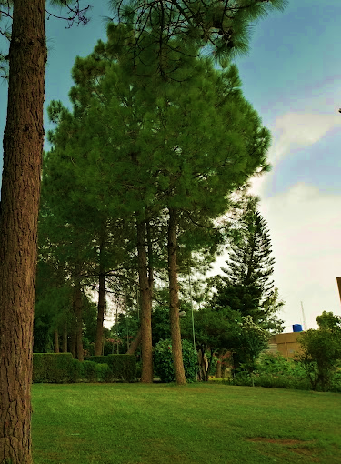
AIOU is implementing its Climate Action Plan 2035 to promote sustainable practices and environmental responsibility. The plan aims to create a campus model for environmental stewardship in higher education, focusing on energy efficiency, renewable energy integration, transportation, waste management, and water conservation. The success of this plan depends on the collaborative efforts of students, faculty, staff, and the local community. By working together, AIOU aims to create a greener, healthier, and more sustainable future for future generations.

Slide 5
AIOU's Climate Action Plan 2035 aims to achieve specific, measurable, achievable, relevant, and time-bound goals to reduce energy usage, greenhouse gas emissions, and promote sustainable transportation. The plan includes a 25% reduction in energy usage by 2035, integrating renewable energy sources, achieving carbon balance, converting 50% of campus vehicles to zero-emission or low-emission options, reducing traffic congestion and emissions, creating carbon-free zones, increasing renewable energy use, implementing a shared commuting service, installing rainwater harvesting sites, reducing waste generation by 40%, and installing water recycling systems that will treat and reuse 30% of campus water for non-drinking purposes by 2035.
Earth is our home. Let's keep it green.

Slide 6
The plan also aims to increase the use of renewable energy sources, with 70% of campus electricity consumed coming from renewable sources by 2035. The plan also aims to create carbon-free zones, promoting sustainable transportation and energy practices, and reducing single-occupancy vehicle trips to campus. Rainwater harvesting sites will capture and store 50% of rainwater for non-drinking purposes by 2035. Waste disposal will reduce overall waste generation by 40% by 2035 through comprehensive waste management practices, recycling programs, and education campaigns. Water recycling systems will treat and reuse 30% of campus water for non-drinking purposes by 2035. These SMART goals ensure accountability and tracking progress throughout the plan's implementation.

Slide 7
STEPS TO PREVENT
Climate Change
Adopt Energy-Efficient Lifestyle
Get involved
in conservation
Green Your
Commute
Utilize renewable energy sources
Reduce
Resuse &
Recycle
Educate yourself and
those around you

Slide 8
reduce CAMPUS carbon footprint
SMALL ACTIONS, BIG IMPACT!
Energy-Efficient Lifestyle:
Unplug electronics when not in use.
Adjust your thermostat to conserve energy.
Opt for energy-saving appliances and LED lights.
Use natural light and open windows for ventilation.
Sustainable Transportation:
Walk or bike for short distances.
Combine multiple errands into one trip.
Opt for fuel-efficient vehicles or electric cars.
Choose public transportation, carpooling, or biking.
Smart Energy Consumption:
Switch to renewable energy providers.
Use energy-efficient insulation in the offices and classrooms.
Minimize air conditioning and heating usage.
Harness solar energy with rooftop solar panels.
Reduce, Reuse, Recycle:
Cut down on single-use plastics.
Recycle paper, plastic, glass, and aluminum.
Compost food waste and use it for gardening.
Embrace reusable bags, bottles, and containers.
Repair and repurpose items instead of discarding them.
Water Conservation:
Collect rainwater for watering gardens.
Fix leaks and dripping faucets promptly.
Water plants efficiently, avoiding excessive irrigation.
Take shorter showers and install water-saving devices.
Conscious Research:
Choose sustainability-based research projects.
Prioritize quality over quantity when presenting.
Fund projects with e. eco-friendly objectives.
Sustainable Food Choices:
Support kitchen gardening within campus.
Opt for internally sourced, organic produce.
Minimize food waste through mindful shopping and meal planning.

Slide 9
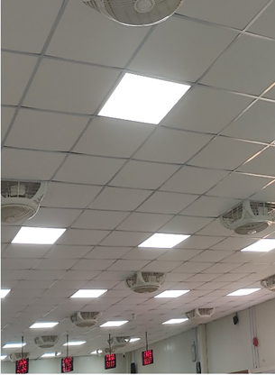
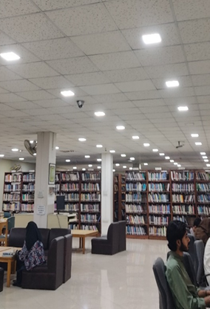
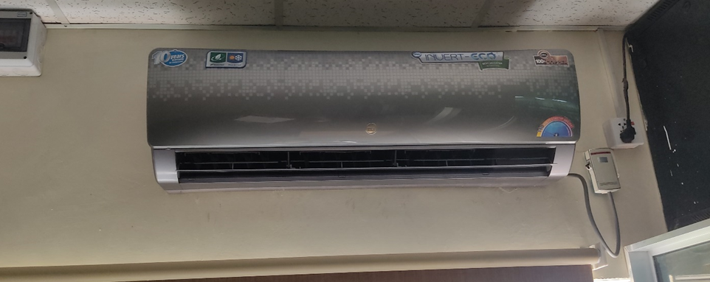
Energy and Climate Change
Performing routine energy audits to find and fix inefficiencies.
Installing energy-saving techniques and technologies in all campus buildings.
Encouraging staff members, instructors, and students to practice energy conservation.

Slide 10
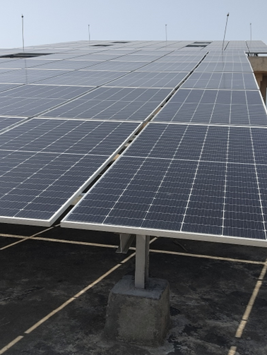
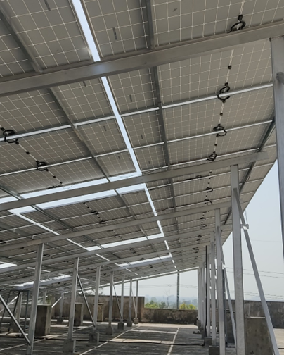
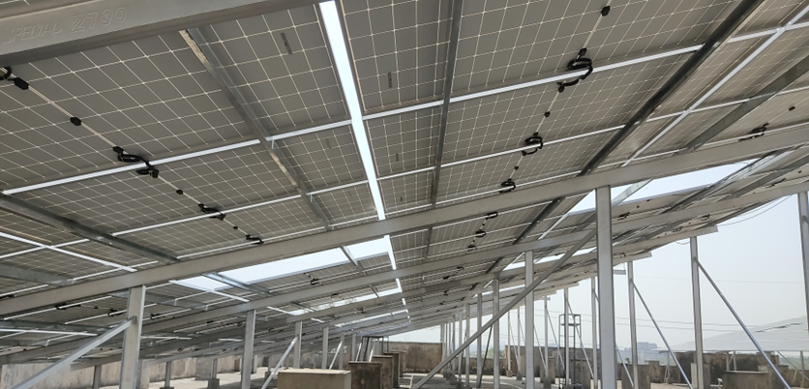
RENEWABLE ENERGY INTEGRATION
1
Use of on-site renewable energy resources should be increased.
2
Looking into join ventures with external suppliers /industrial partners for renewable energy.
3
Creating a plan of action to ensure that the university's energy mix includes a sizable portion of renewable energy.
THIS IS
OUR FUTURE

Slide 11
GREEN
ENERGY
The plan includes the use of on-site renewable energy resources, like wind turbines and/or solar panels. It should be increased.
Clean - Efficient - Sustainable
Hydropower
Wind Energy
Geothermal Energy
Solar Power

Slide 12
Sustainable Campus Development
Including sustainable design concepts in newly constructed buildings.
Modernizing current infrastructure to comply with environmental regulations.
In campus development plans, giving green spaces and biodiversity top priority.

Slide 13
Greenhouse Gas Emission Reduction Program
Save the Planet and The Future by:
Setting up of measurable and precise goals.
Tracking and reporting
Low or zero-emission automobiles.
Using electric or hybrid cars

Slide 14
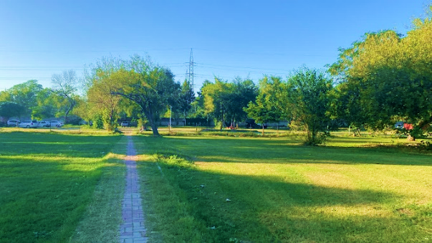
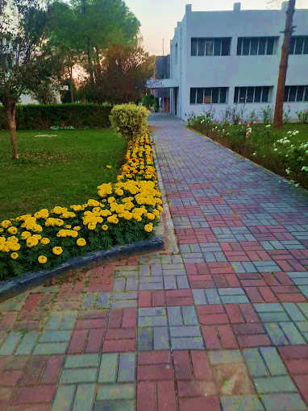
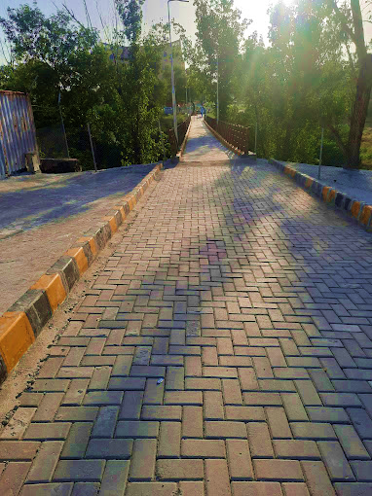
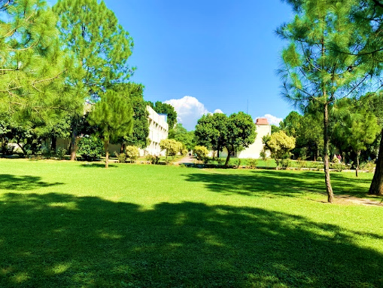
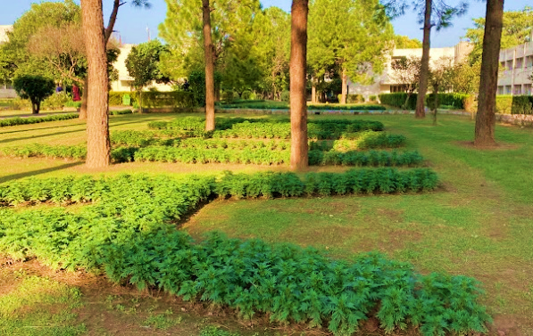
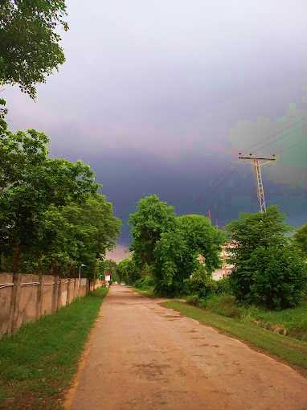
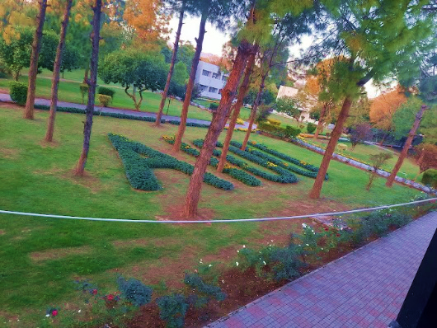
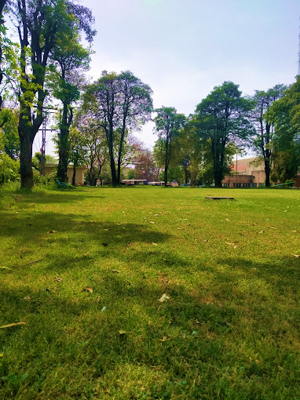
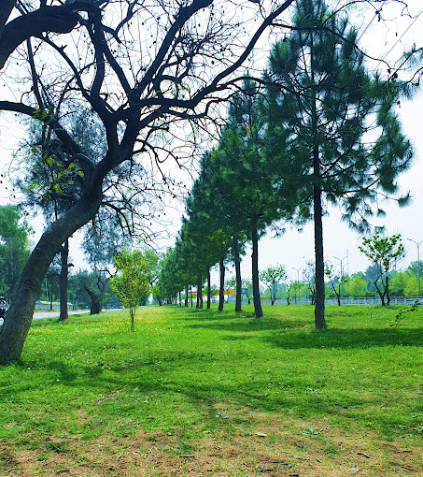
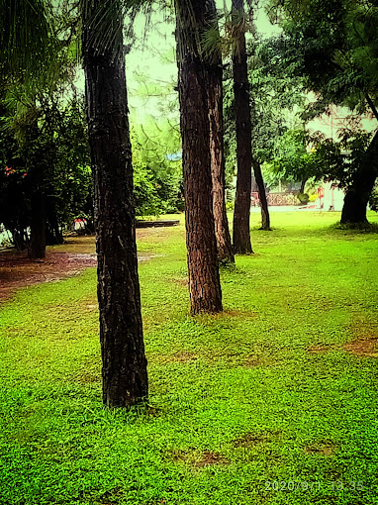
AIOU

Slide 15
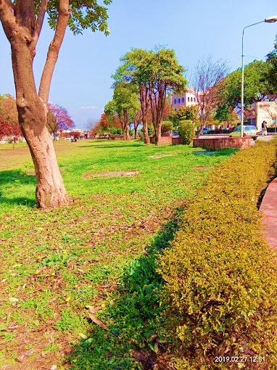
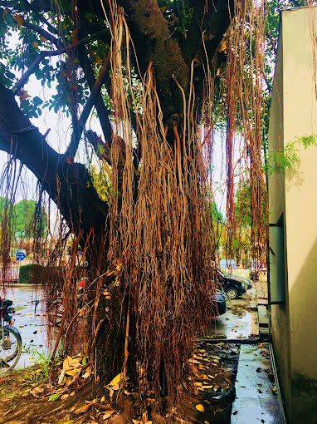
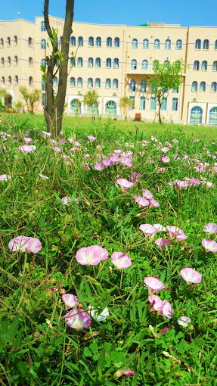
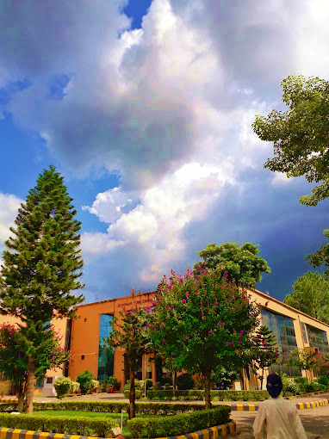

Slide 16
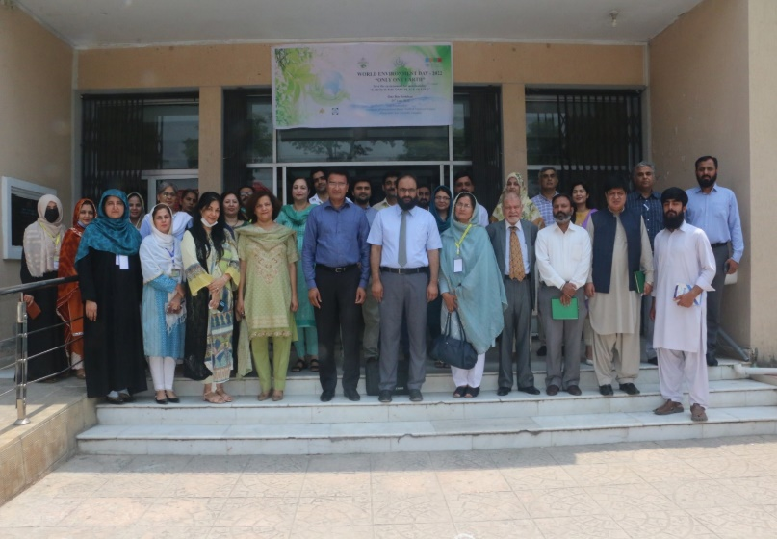
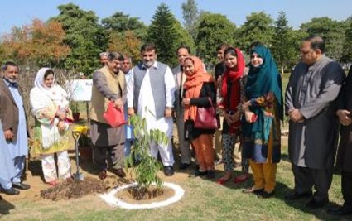
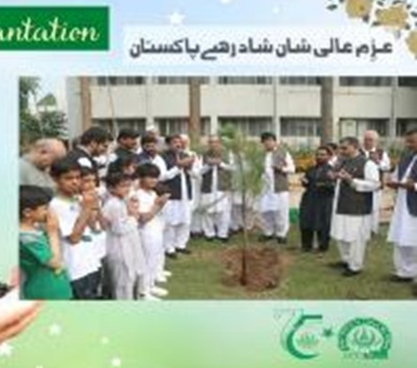
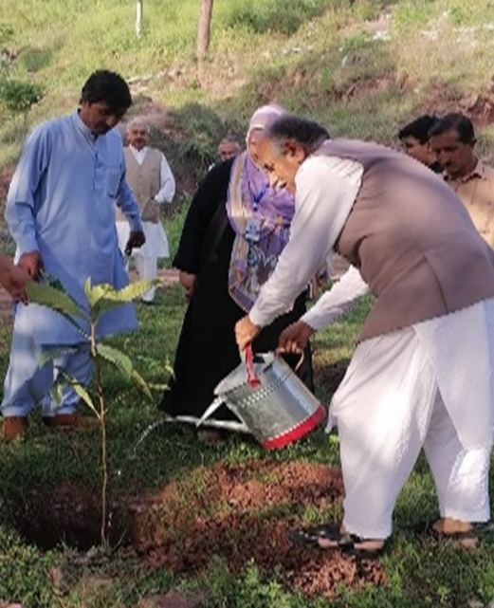
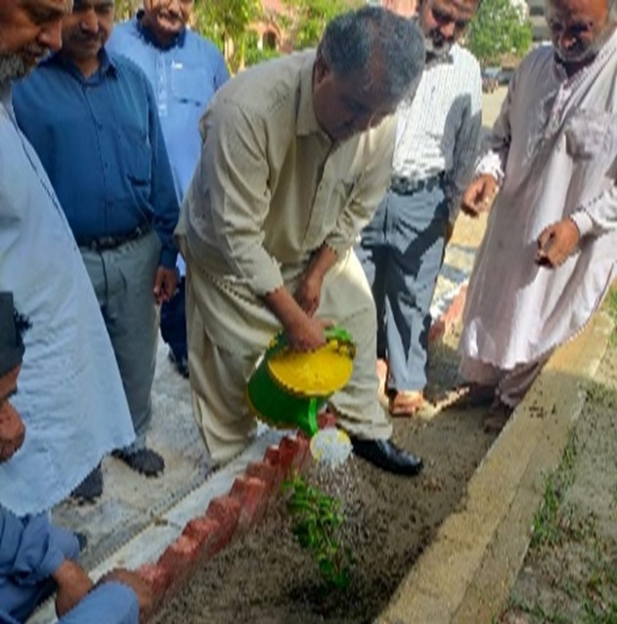
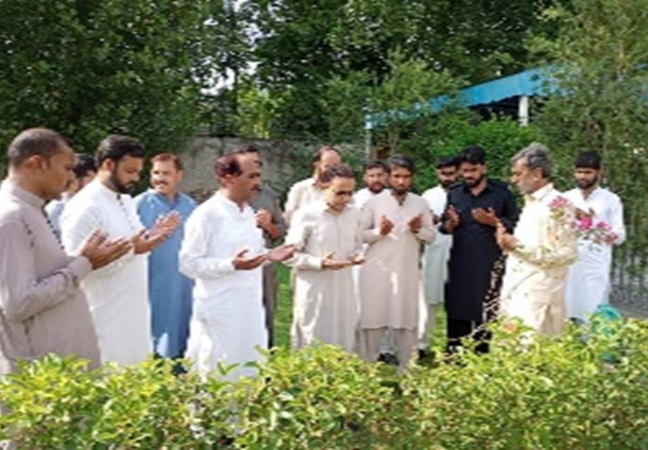
Environment Promotion Activities
at AIOU

Slide 17
SAVE WATER
SAVE LIVES
Water Recycling
Installing water recycling systems will allow campus water to be treated and reused.
Examining recycling greywater for uses other than drinking water.
Informing the public about the value of recycling and water conservation

Slide 18
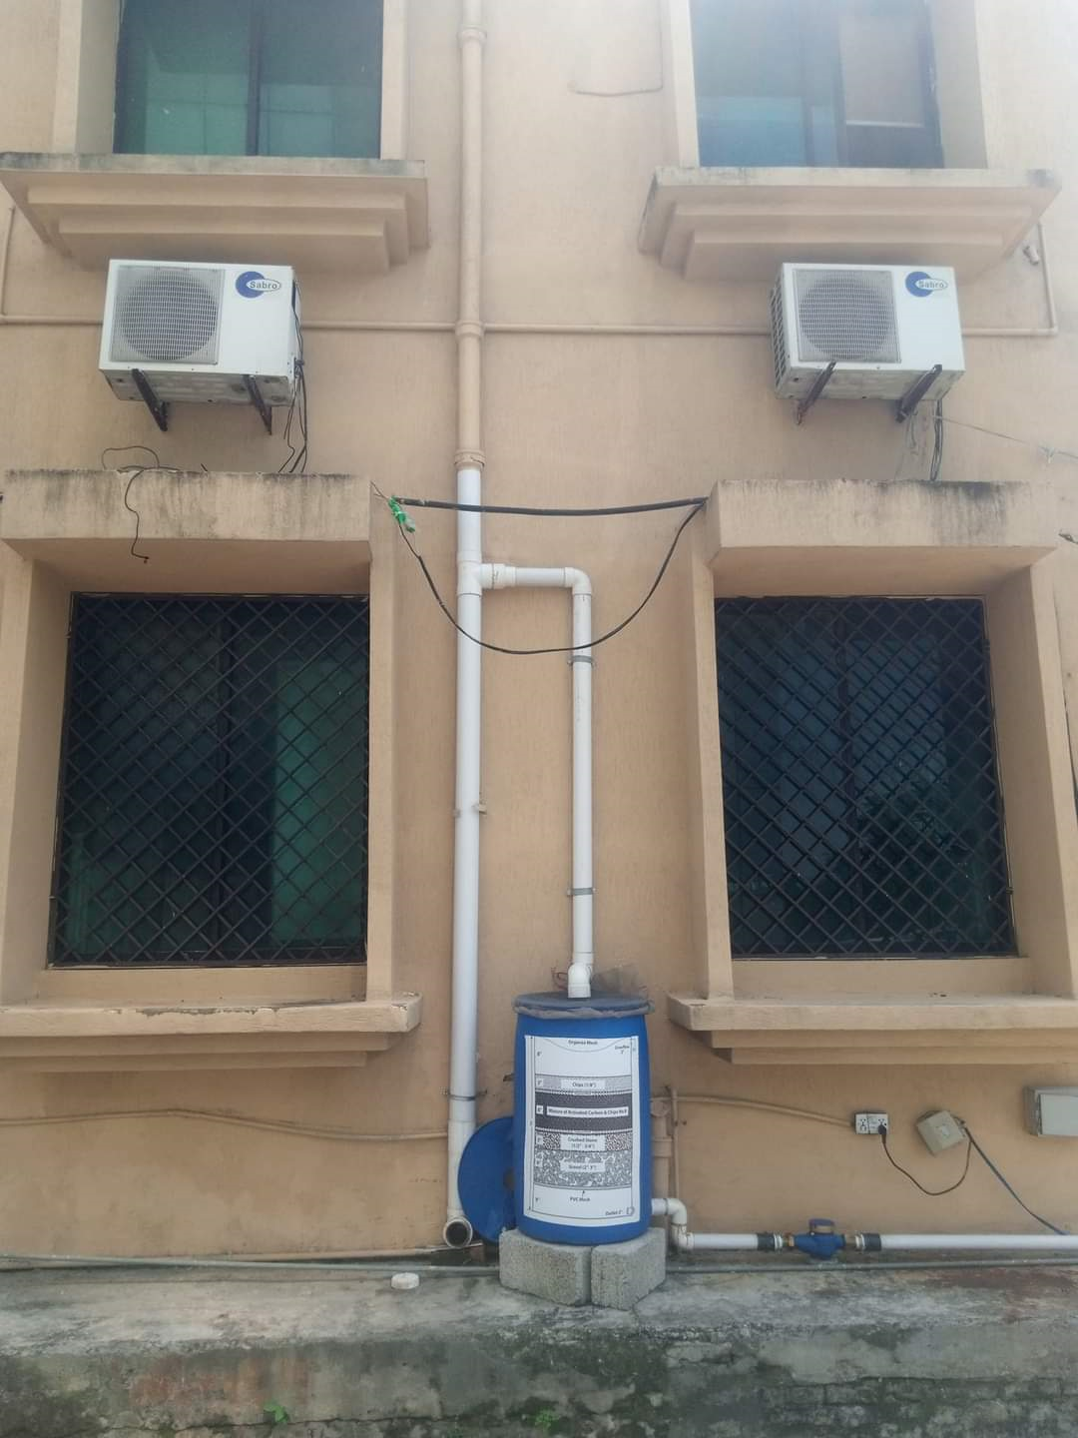
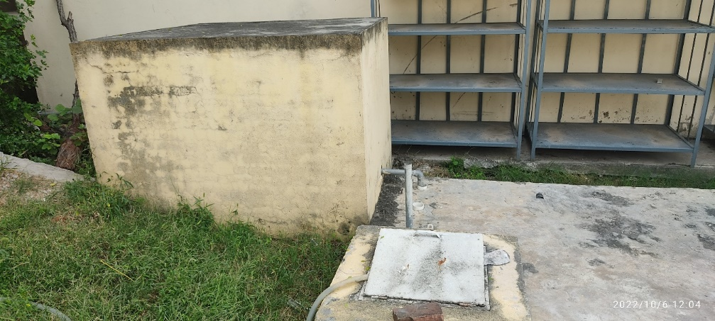
A glimpse
of
water
Conservation
and
recycling
at AIOU

Slide 19
Smart Targets for Climate Action Plan 2035
Energy and Climate Change
Incorporate energy-efficient practices and technologies to cut the amount of energy used in all campus buildings and facilities by 25% over the baseline year.
Renewable Energy Integration
By 2035, produce half of the university's energy from on-campus renewable resources (wind, solar, etc.), and form alliances to guarantee that the remaining half is produced from off-campus renewable resources.

Slide 20
LET'S PRESERVE OUR PLANET!
Use of Renewable Energy Sources
By 2035, 70% of the electricity consumed on campus will come from renewable sources, with a combination of on-site generation and purchases from renewable energy providers.
Shared Commuting Service
Through incentives, awareness campaigns, and infrastructure improvements, AIOU will create a shared commuting service that results in a 25% reduction in single-occupancy vehicle trips by 2035.
Rainwater Harvesting Sites
AIOU will install rainwater harvesting systems at strategic locations to capture and store 50% of rainwater for non-drinking purposes by 2035.

Slide 21
Greenhouse Gas Emission Reduction Program
AIOU aims to create and implement initiatives to cut greenhouse gas emissions by half by 2035, with the ultimate goal of achieving carbon balance through investment in carbon offset projects.
Out-of-Campus Parking of Private Vehicles
Establish designated off-campus parking areas and encourage the use of public transportation, resulting in a 30% reduction in on-campus private vehicle usage by 2035.
Zero Emission Vehicles for Campus
By 2035, 50% of the university's vehicles will be zero-emission or low-emission, with an emphasis on electric or hybrid options.
Carbon-Free Zones
Designate specific areas on campus as carbon-free zones, and promote sustainable transportation and energy practices to achieve a 20% reduction in carbon emissions within these zones.

Slide 22
GREENER
AND
SAFER
Waste Disposal
Reduce overall waste generation on-campus by 40% by 2035 by implementing comprehensive waste management practices, recycling programs, and education campaigns.
Water Recycling
AIOU aims to install water recycling systems that will treat and reuse 30% of campus water for non-drinking purposes by 2035, with a focus on greywater recycling.

Slide 23
REDUCE
Organic & Inorganic waste
AIOU has
Zero Waste
Policy
REUSE
Use eco-friendly with reusable bags
RECYCLE
Clothes, materials, food, bottles and cans
www.aiou.edu.pk

Slide 24
AIOU stresses
SOLUTION FOR PLASTIC POLLUTON
Promote recycling and reuse
Improve waste management
Advocate for policy change
Innovate new materials

Slide 25
PUT TRASH IN ITS PLACE

Slide 26
How to Handle Campus Trash
Step 1: Reduce.
Buy long-lasting products with minimal or no packaging to minimize the trash generation.
Step 2: Reuse.
Think twice before putting an item in the trash. Find another use for it, donate, or sell it.
Step 3: Recycle.
Segregate campus trash by type. Contact local recyclers to collect the non-recycleable trash.
Step 4: Make compost.
Gather fruit and vegetable scraps and make a compost pile in campus lawns.
Step 5: Dispose trash in a landfill.
Throw trash in a landfill only if you still have trash left after following the other four steps.
Throw trash away responsibly.

Slide 27
Allama Iqbal Open University's Climate Action Plan 2035 represents a bold and visionary commitment to sustainable practices and environmental responsibility. AIOU aims to create a campus that is a model for environmental stewardship in higher education by setting ambitious goals in areas such as energy efficiency, renewable energy integration, transportation, waste management, and water conservation. This plan's success is dependent on the collaborative efforts of students, faculty, staff, and the local community. As we go on this transformative journey, AIOU reiterates its commitment to creating a greener, healthier, and more sustainable future for future generations. We can have a significant and long-term impact on the environment and inspire positive change outside the university if we work together.

Slide 28
STOP CLIMATE CHANGE
Our Actions
shape
the World
Allama Iqbal Open University
Islamabad-Pakistan

